Slide 1
Political Discourse on Social Media
Echo Chambers, Gatekeepers, and the Price of Bipartisanship
Kiran Garimella, Gianmarco De Francisci Morales,
Aristides Gionis and Michael Mathioudakis

Slide 2
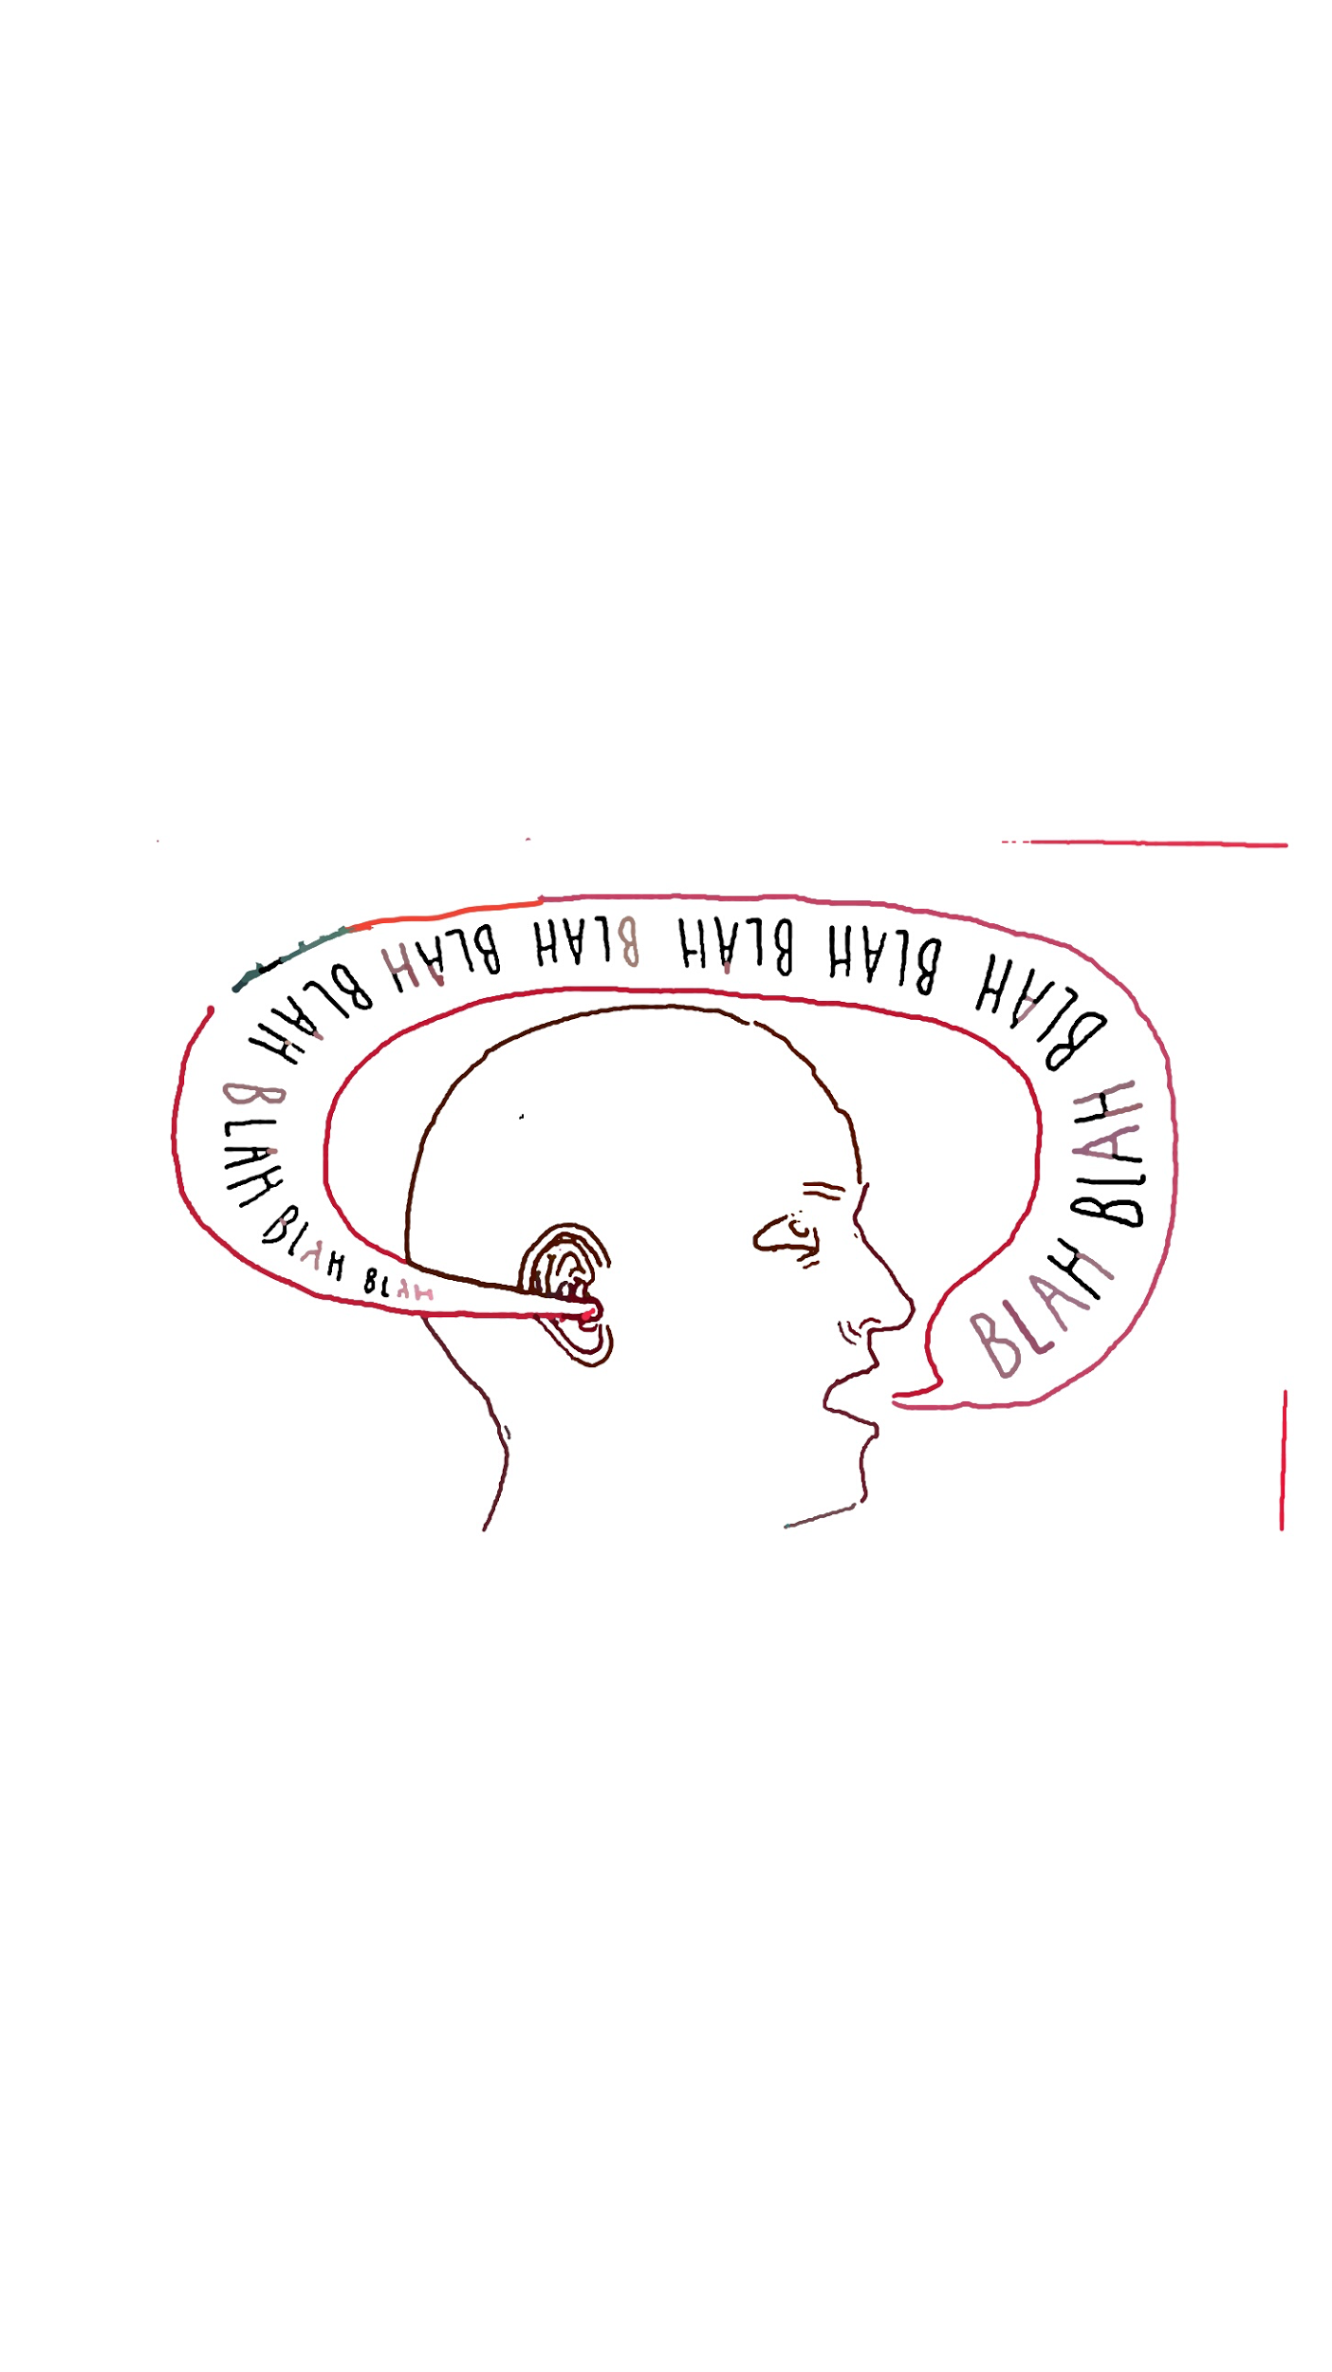
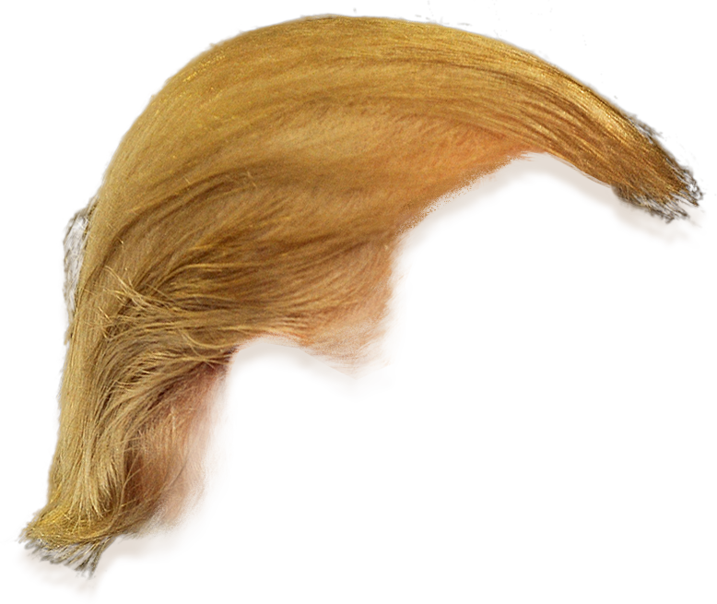
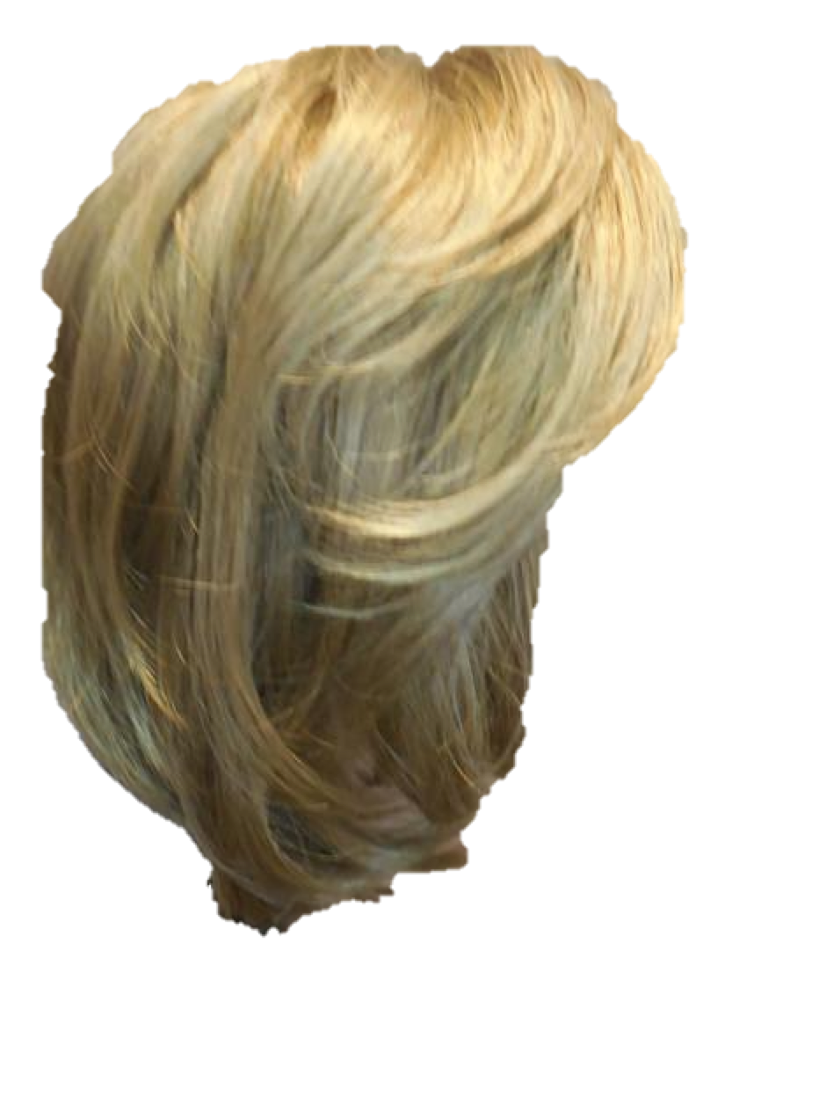
Echo Chambers
‘A situation in which social media users are more likely to engage with people and media sources that share their political beliefs, hence reinforcing their own opinions.’
Notes:
Political echo chambers only!
Should I give more details?? Or can I assume that people know what echo chambers are?

Slide 3
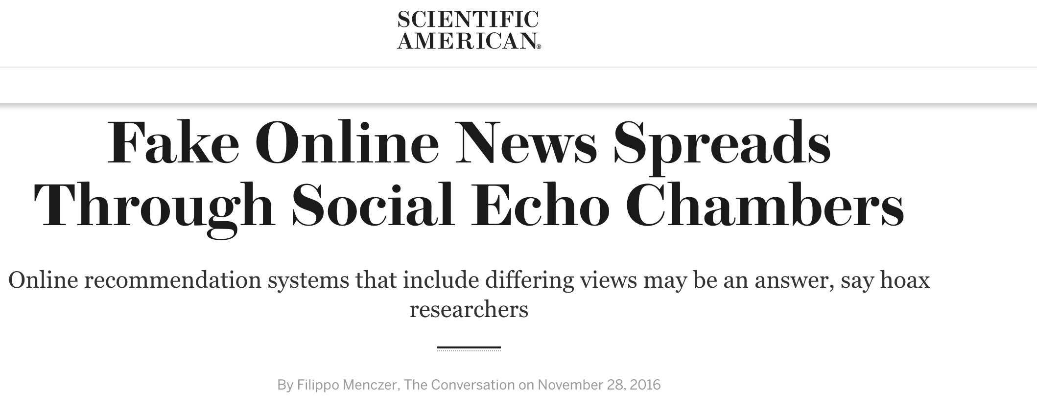
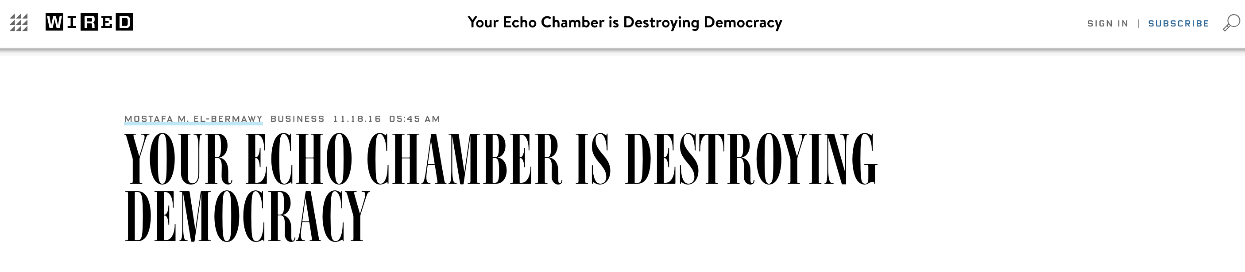
Why should we care?

Slide 4
Contributions
What is an echo chamber?
Interplay between network and content
Whether social media users are in echo chambers?
Who are the actors involved?
Notes:
Are people in echo chambers because they do not read about the other side or is it because

Slide 5
Methodology
What people produce vs. what they consume
Echo chamber if:
People produce ideologically similar content as what they consume
Notes:
the political leaning of the content that users receive from the network agrees with that of the content they share.
Mention US Politics and Twitter!!!

Slide 6

Model
Consumption
Production

Slide 7
Model
Consumption
Production

Slide 8
Setting
US Politics
Twitter

Slide 9
Polarity score of a tweet
Ideology score of a tweet = ideology of the news domain in the tweet.
Notes:
How do we take care of negation? (e.g. such a stupid post..)

Slide 10
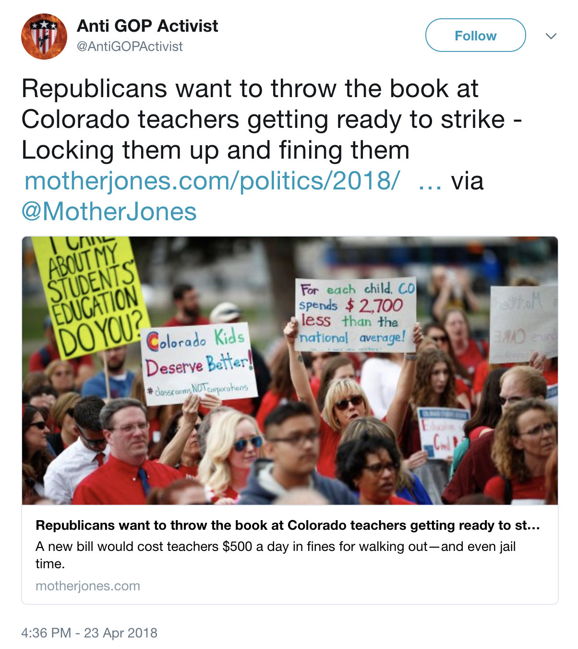
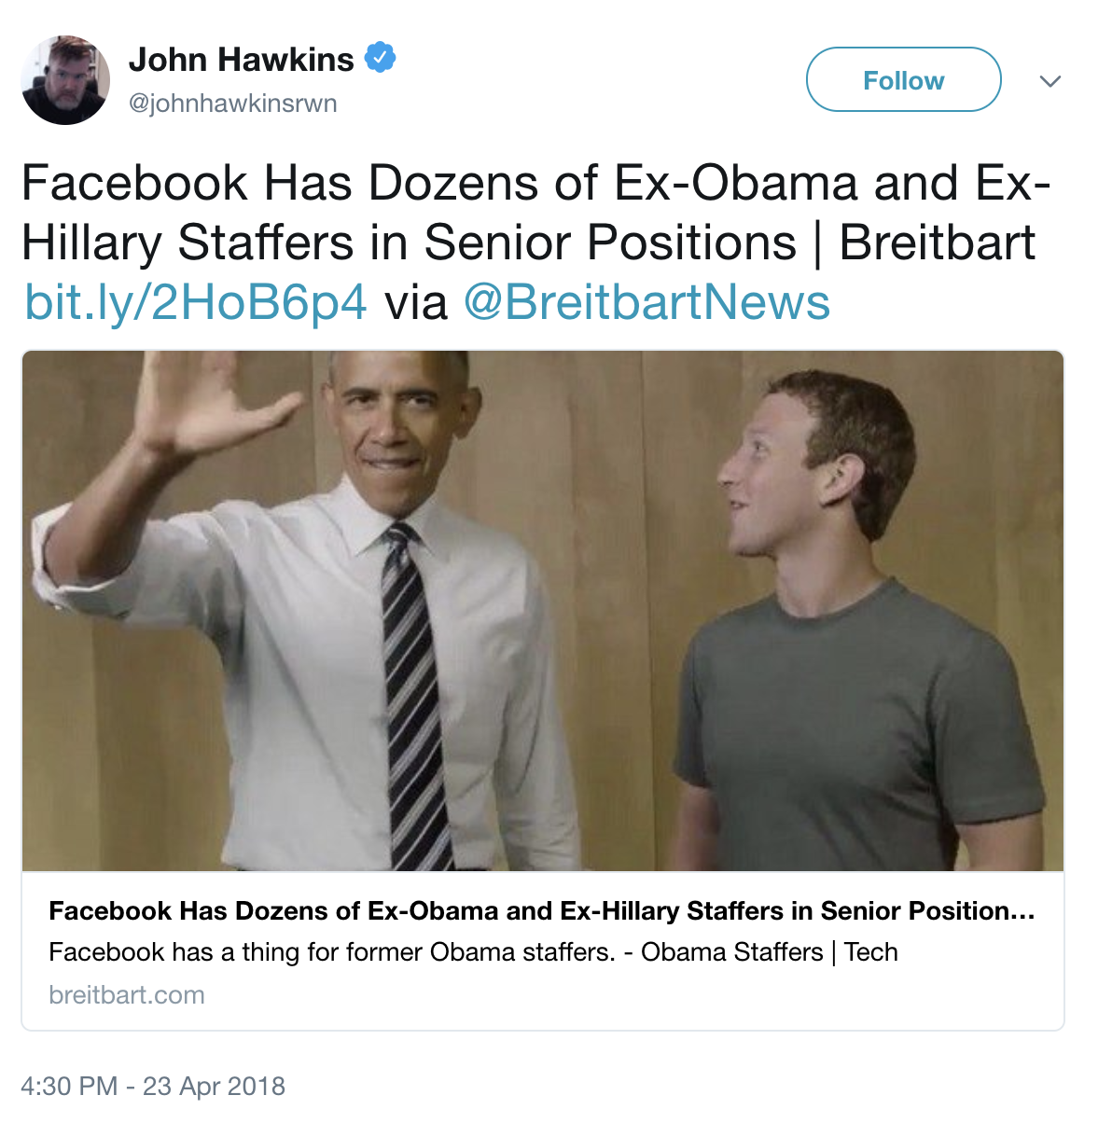
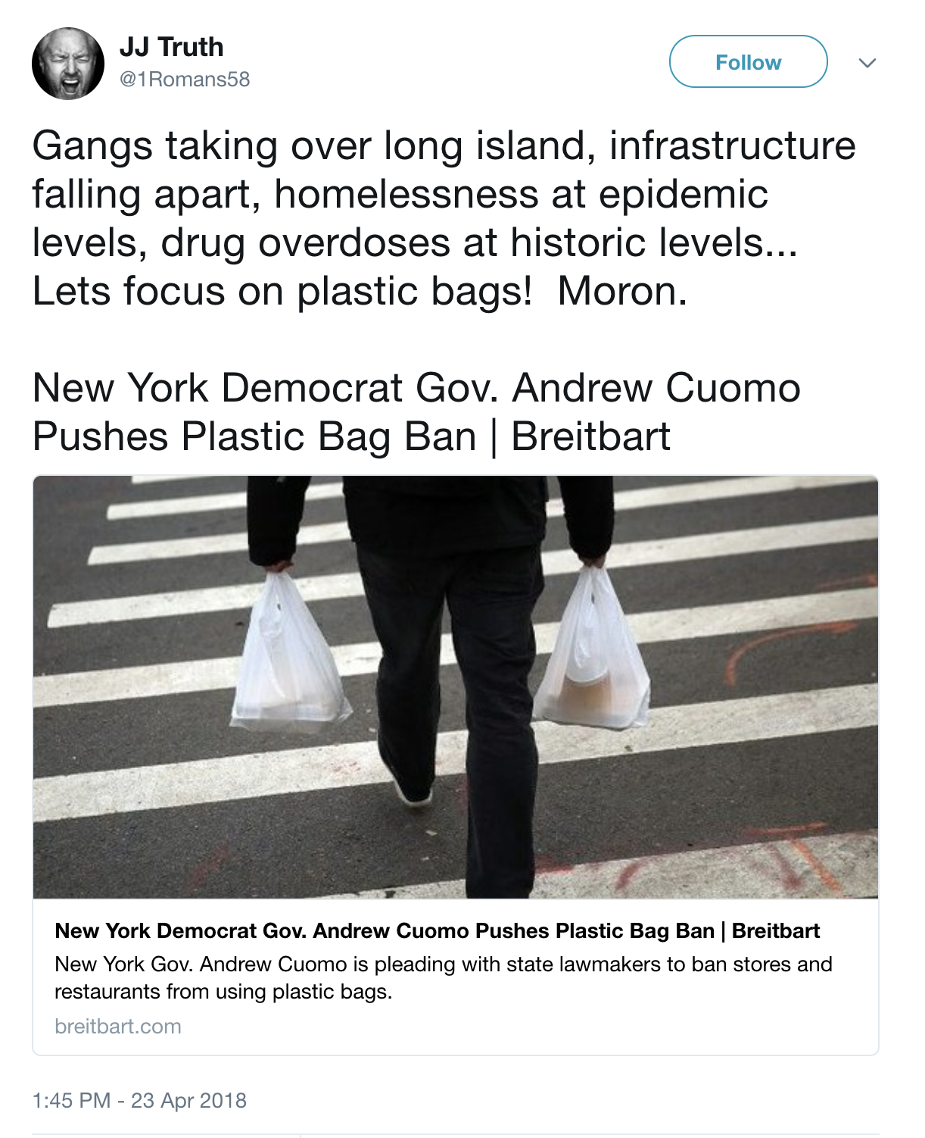
Polarity score of a tweet
Polarity: 0.92
Polarity: 0.09
Ideology score of a tweet = ideology of the news domain in the tweet.
Notes:
How do we take care of negation? (e.g. such a stupid post..)

Slide 11
Polarity score of a tweet
Ideology score of a tweet = ideology of the news domain in the tweet.
500 most visited domains on Facebook from Bakshy et al., Science 2016.
Notes:
How do we take care of negation? (e.g. such a stupid post..)

Slide 12
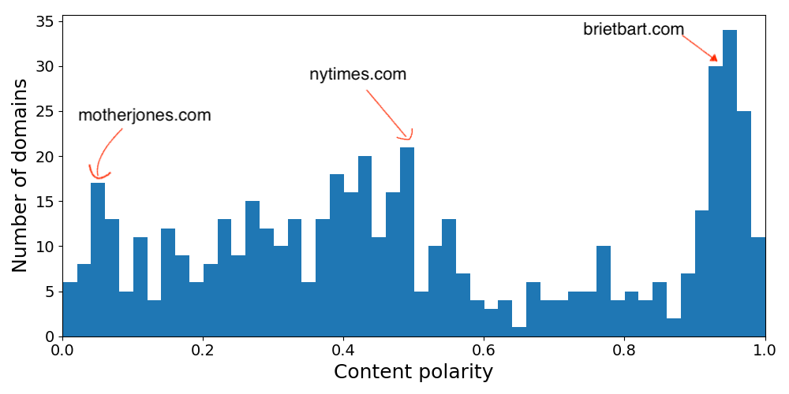
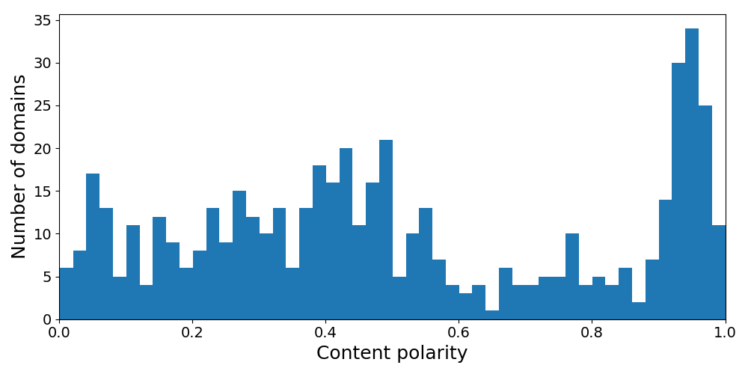
Polarity score of a tweet
Ideology score of a tweet = ideology of the news domain in the tweet.
500 most visited domains on Facebook from Bakshy et al. (Science 2016).
Notes:
How do we take care of negation? (e.g. such a stupid post..)

Slide 13
Production polarity
Production polarity = average polarity of content tweeted by a user.
Range – 0 (liberal) to 1 (conservative)
Consumption
Production
Notes:
Should I give examples??

Slide 14
Consumption polarity
Average polarity of content received.
Approximate it from the network.
Consumption
Production
Notes:
Beauty: combines network and content

Slide 15
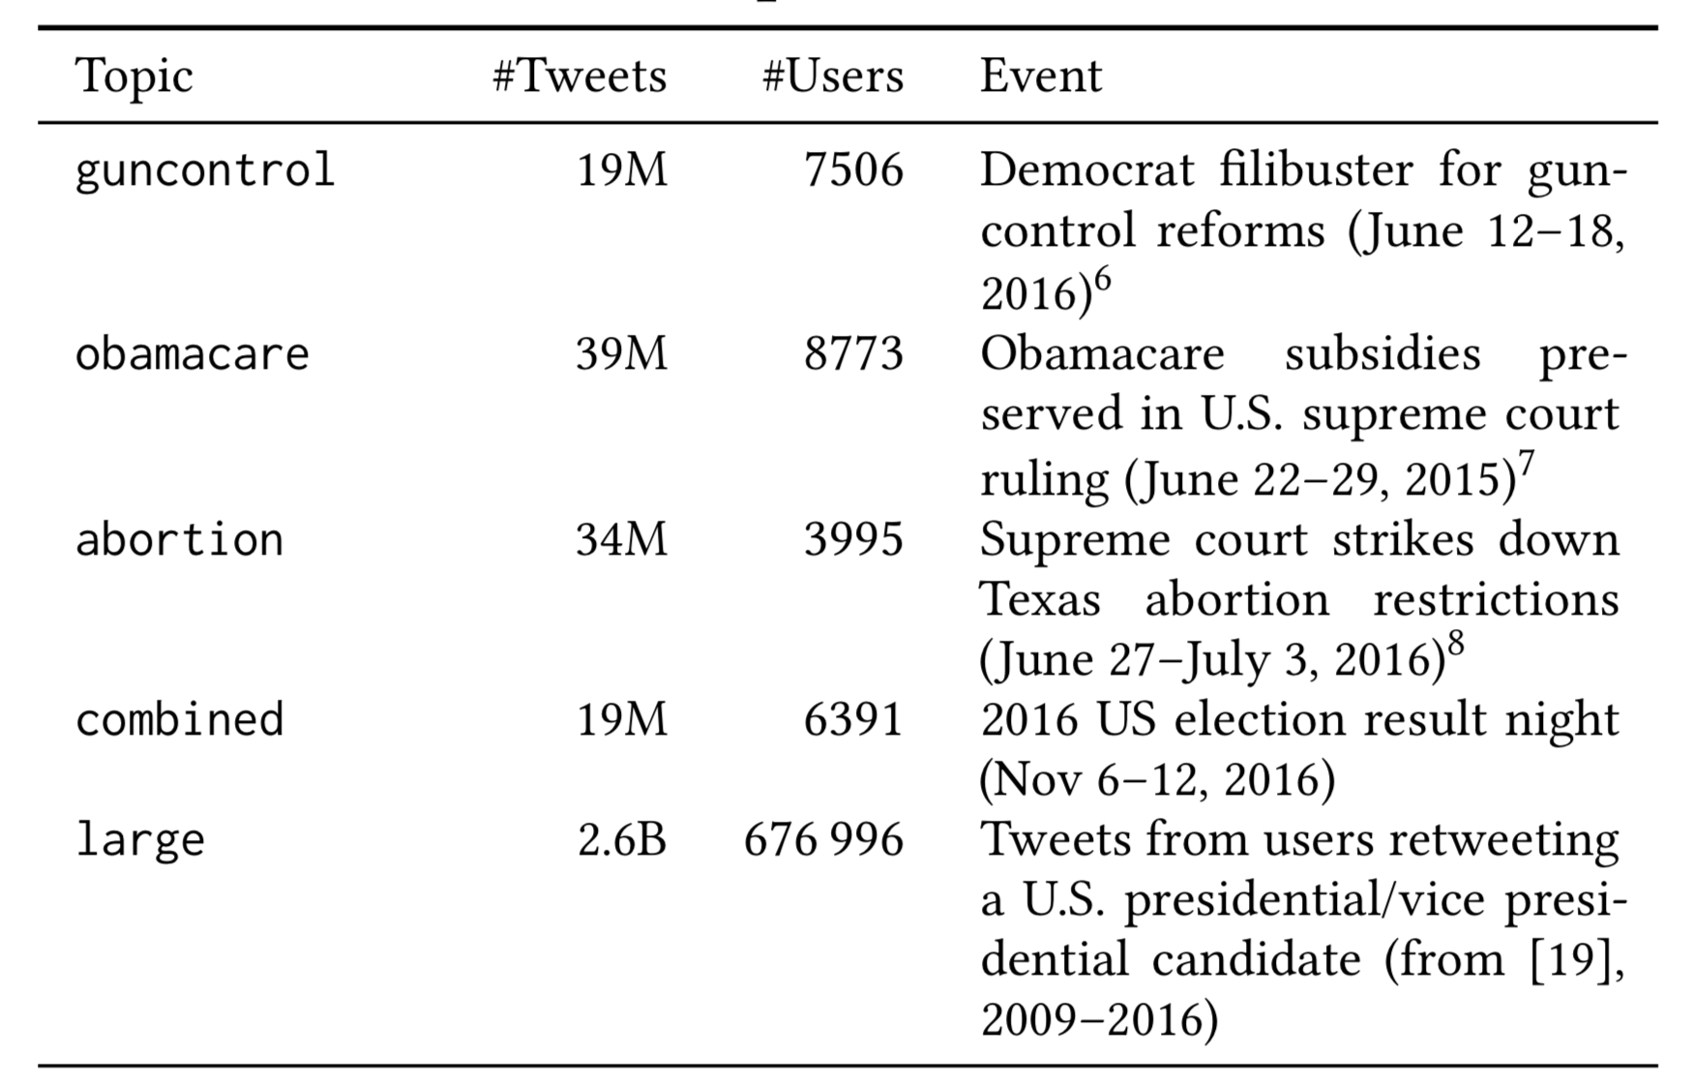
Data
5 political datasets from different timespans.

Slide 16
Do echo chambers exist on Twitter?
Do users produce and consume content from the same side?

Slide 17
Do echo chambers exist on Twitter?
Yes!!

Slide 19
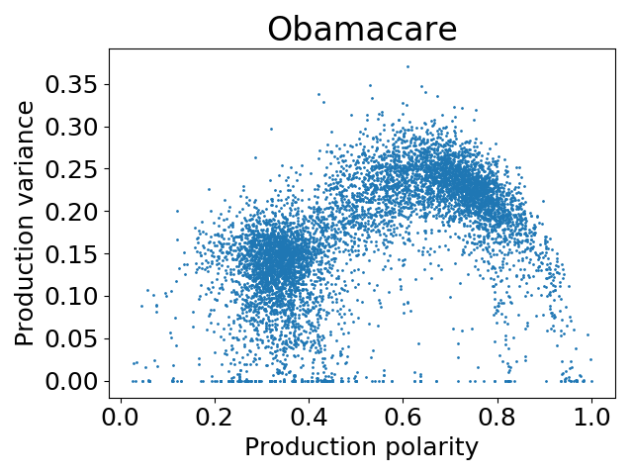
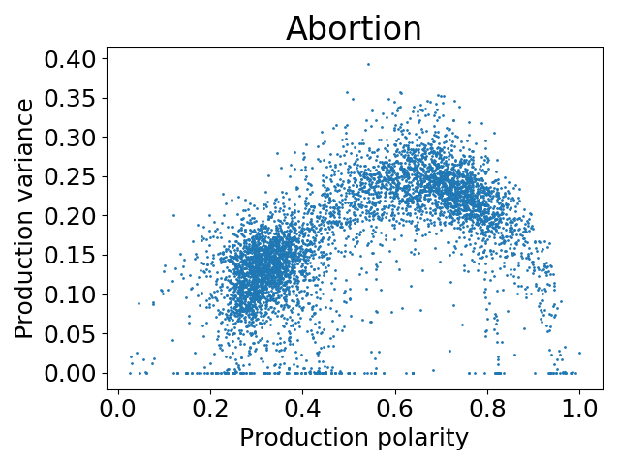
Production variance
High Production variance = less polarized

Slide 20
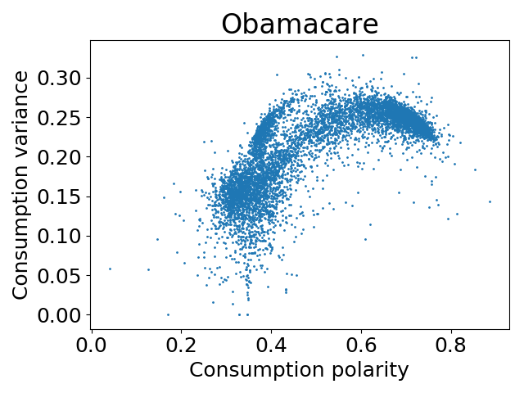
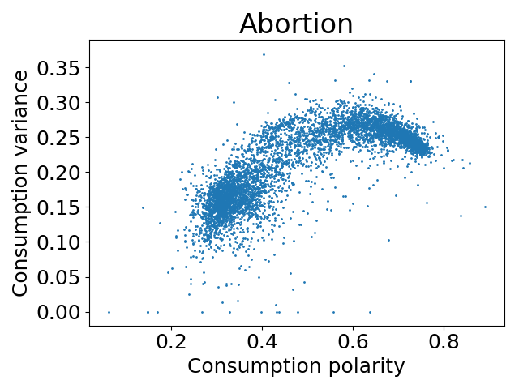
Consumption variance

Slide 21


Partisan users
Production only from one side
Production
Production
Source: http://com201.ekrotulis.com/httpcom201-ekrotulis-compolitics/trump-vs-hillary/
https://appadvice.com/app/trumpoji-donald-trump-emoji-keyboard/1089624476

Slide 22

Bi-partisan users
Production from both sides of the political spectrum
Production

Slide 23
Partisans vs. bipartisans
How do partisan users differ from bipartisan users?

Slide 24
Partisans vs. bipartisans
Pagerank
Notes:
👍

Slide 25

Partisans vs. bipartisans
Pagerank
Partisan users have a higher pagerank
Notes:
👍

Slide 26
Partisans vs. bipartisans
Clustering coefficient
Partisan users are better embedded in their communities
Notes:
👍

Slide 27
Partisans vs. bipartisans
Number of Retweets/Favorites
Partisan users get better engagement on their tweets
Notes:
👍

Slide 28
Partisans vs. bipartisans
There is a price for being bipartisan
Measure | Partisans | Bi-partisans
Pagerank | ✔ | ✖
Degree | ✔ | ✖
Clustering coefficient | ✔ | ✖
Polarity | ✔ | ✖
# Retweets | ✔ | ✖
# Favorites | ✔ | ✖
✔ = higher value
Notes:
👍

Slide 29

Gatekeepers
Users who consume content from both sides but only produce on one side
Gatekeepers act as ‘filters’ of information
Consumption
Production
Source: https://appadvice.com/app/trumpoji-donald-trump-emoji-keyboard/1089624476

Slide 30
Gatekeepers
Measure | Gatekeepers | Non gatekeepers
Pagerank | ✔ | ✖
Degree |  | ✖
Clustering coefficient | ✖ | ✔
Polarity | ✖ | ✔
✔
✔ = higher value
Notes:
Similarly, their polarity score is on average less extreme than the rest of their group.

Slide 31
Prediction
Can we predict partisans and gatekeepers?
Features:
Tweet features: n-grams with tf-idf weights from their tweets
Profile features: number of tweets, of followers, of friends, age on Twitter
Network features: PageRank, degree, clustering coefficient

Slide 32
Predicting partisans
Dataset | n-gram | network + profile | combined
Combined | 0.73 | 0.71 | 0.81
Obamacare | 0.78 | 0.75 | 0.83
Abortion | 0.76 | 0.71 | 0.80
Guncontrol | 0.76 | 0.70 | 0.83
Large | 0.74 | 0.72 | 0.78
Accuracy for partisans vs. non partisan users using a Random Forest

Slide 33
Predicting gatekeepers
Dataset | n-gram | network + profile | combined
Combined | 0.65 | 0.67 | 0.67
Obamacare | 0.64 | 0.65 | 0.66
Abortion | 0.65 | 0.63 | 0.69
Guncontrol | 0.62 | 0.64 | 0.67
Large | 0.68 | 0.70 | 0.75
Accuracy for gatekeepers vs. non gatekepers using a Random Forest

Slide 34
Summary
Definition of echo chambers
Production and consumption of information
Interplay between network and content
Notes:
Countries like myanmar and sri lanka it is a necessity

Slide 35
Summary
Political echo chambers exist!
Price of bipartisanship
Possible to predict partisans and gatekeepers

Slide 36
Implications
Can we help users get out of these echo chambers?
Can we counteract the price of bipartisanship?
Different users might play a role!
Gatekeepers are important

Slide 37
Thank you!
🤝
@gvrkiran
@gdfm7
@gionis
@mmathioudakis

